Slide 1
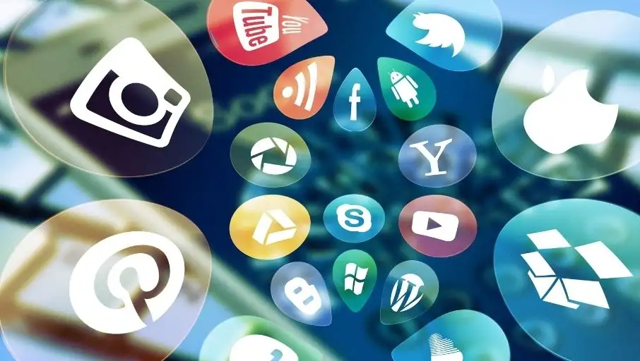

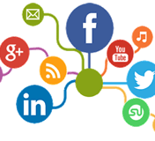
SOCIAL MEDIA BIG DATA ANALYTICS – a sURVEY

Slide 2
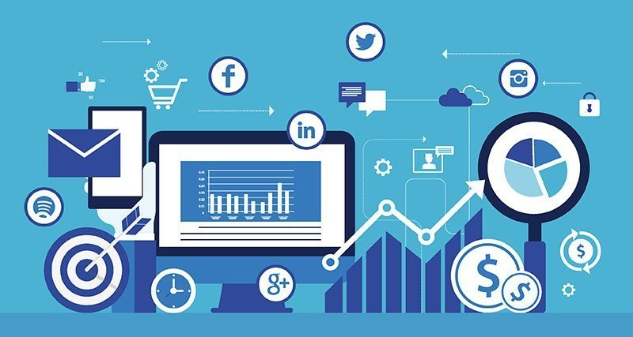
abstract
Through Social Media platforms, people can transmit pictures, videos, opinions, and various kinds of content among their friends and followers. Throughout the last decade, with the growth of social media, analytics of data which is generated by social media platforms is much-needed action for recognizing users’ practices and behaviors. As per Sahatiya (2018), There is a unit of over 900 social media sites on the market on the net. Within this presentation, we would like to discuss analytics in the context of Big data that is generated by various social media platforms and how the process of Big Data Analytics is being performed on this data.

Slide 3
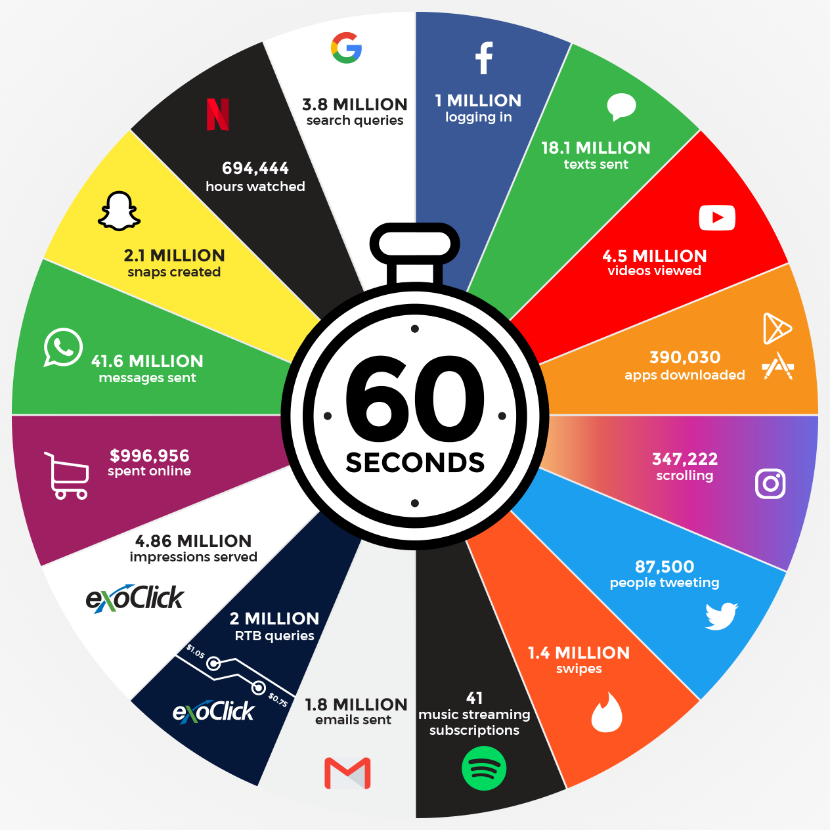
estimation of Social media data per minute
Image Credits:- https://www.exoclick.com/do-you-know-what-happens-in-1-minute-on-the-internet/

Slide 4
Data sources used in the given research
46% of the current studies perform analysis on tweets produced in microblogging.
A total of 17% of these studies perform analysis on reviews by users, such as product and movie reviews.
The comments are also considered the opinions and views tracked in textual content.
Moreover, 10% of these studies use blogpost as their data sources, while news articles and forum posts are used for analysis by 9% and 7% of the selected studies, respectively.
A total of 5% of the studies use Q&A posts (from question and answers sites) as their data source. Similarly, tags in sites, such as Tumblr and Flickr, are also used by 5% of the selected studies.

Slide 5
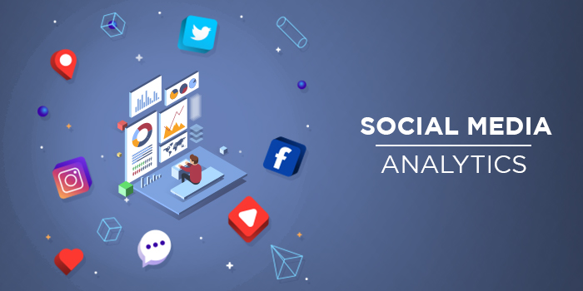
Social media big data analytics - introduction
Social media big data analytics is defined as the process of gathering unstructured information from various social media platforms to derive valuable customer and behavioral insights that support important business decision-making process and social campaigns.
Big data analytics on social media is the key to ensuring a high level of performance in social media campaigns and making data-driven decisions. It helps your social media team learn what works and what doesn't in terms of content and strategy. This analysis is based on the level of audience retention, conversion, and reach.

Slide 6
Big data
The definition of big data is data that contains greater variety, arriving in increasing volumes and with more velocity. This is also known as the three Vs. It also can be defined as data sets whose size or type is beyond the ability of traditional relational databases to capture, manage and process the data with low latency.
Big Data is about “datasets whose size is beyond the ability of typical database software tools to capture, store, manage, and analyze.”

Slide 7
Big data (Cont.,)
Volume:- The amount of data matters. With big data, you’ll have to process high volumes of low-density, unstructured data. This can be data of unknown value, such as Twitter data feeds, clickstreams on a web page or a mobile app, or sensor-enabled equipment. For some organizations, this might be tens of terabytes of data. For others, it may be hundreds of petabytes.
Velocity:- Velocity is the fast rate at which data is received and (perhaps) acted on. Normally, the highest velocity of data streams directly into memory versus being written to disk. Some internet-enabled smart products operate in real-time or near real-time and will require real-time evaluation and action.
Variety: -Variety refers to the many types of data that are available. Traditional data types were structured and fit neatly in a relational database. With the rise of big data, data comes in new unstructured data types. Unstructured and semi-structured data types, such as text, audio, and video, require additional preprocessing to derive meaning and support metadata.

Slide 8
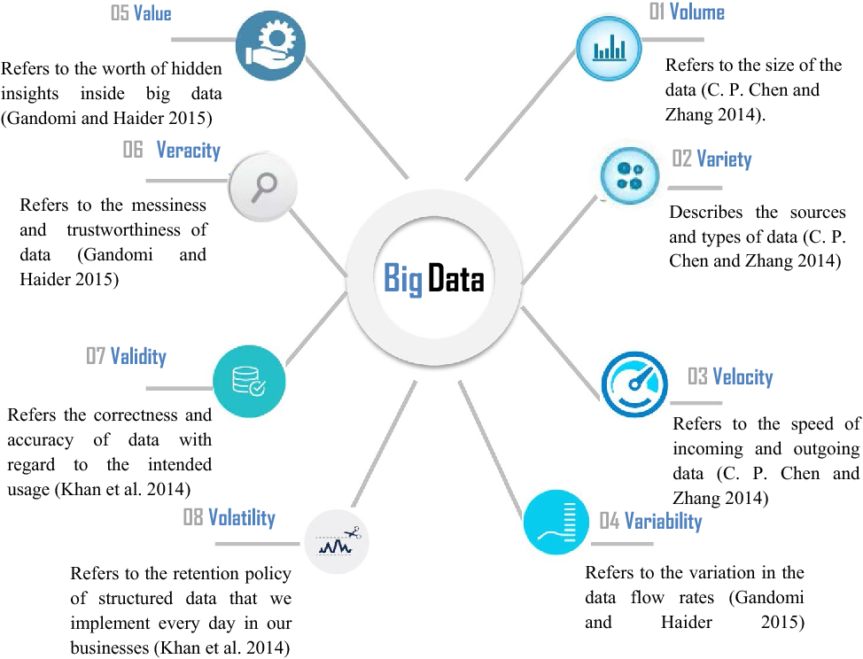
Big Data comprehensive dimensions as 8 v’s

Slide 9
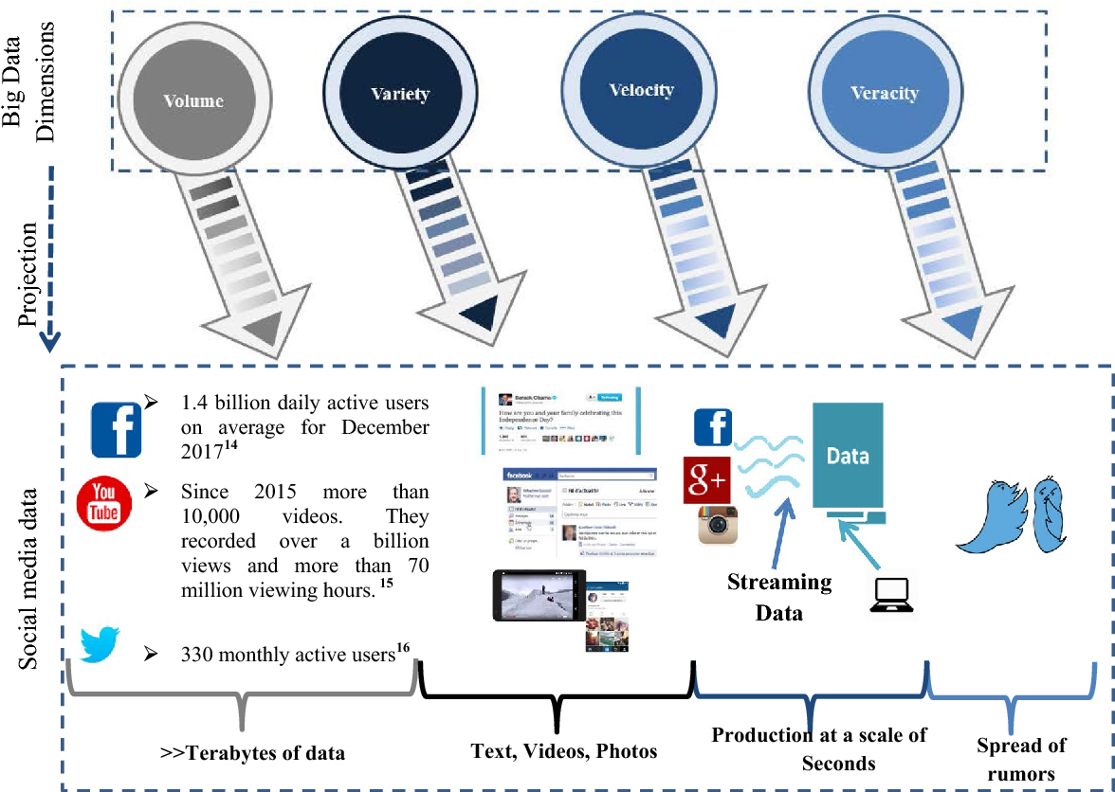
Projection of big data dimensions on social media data

Slide 10
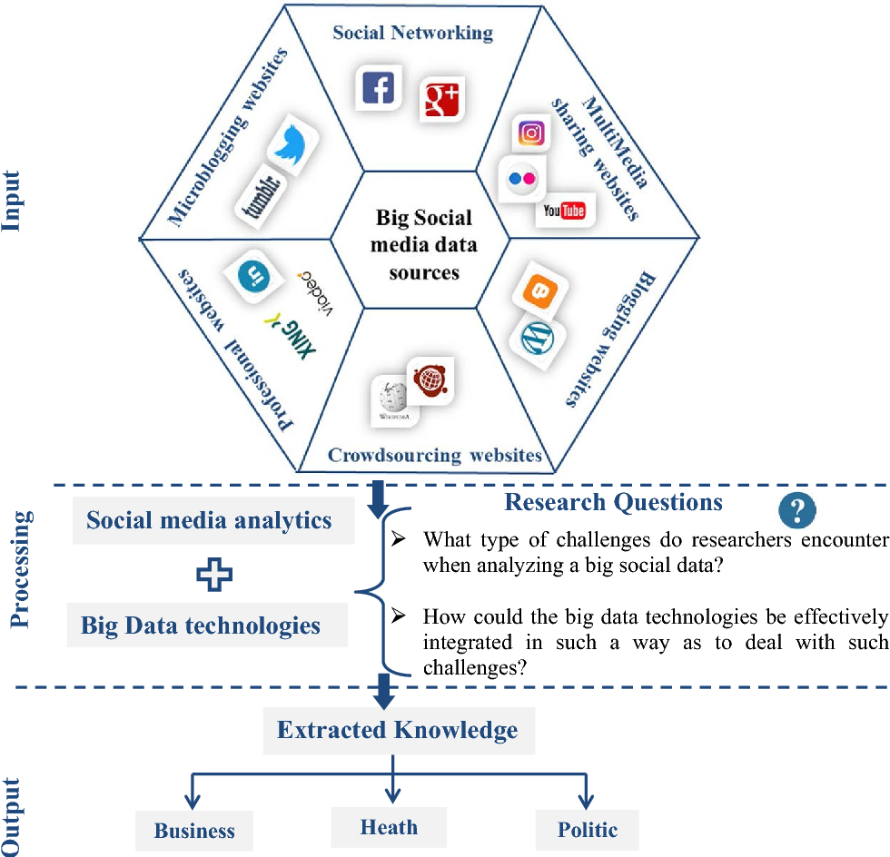
SOCIAL MEDIA BIG DATA SOURCES & RESEARCH QUESTIONS

Slide 11
Types of social media
Category | Examples
Social news | Digg, Slashdot
Social bookmarking | Delicious, StumbleUpon
Social networking platform | Facebook, LinkedIn, Instagram
Microblogs | Twitter, GoogleBuzz
Opinion mining | Epinions, Yelp
Photo and video sharing | Flickr, YouTube
Blogs | Blogger, LiveJournal, WordPress

Slide 12
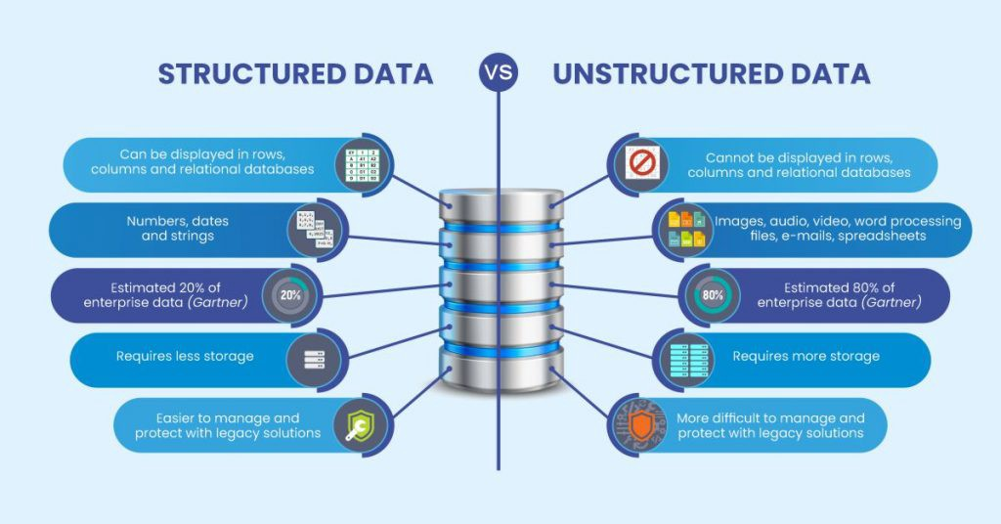
Structure & unstructured data
Most of Social Media data is Unstructured data as it contains various types of files such as images, audios, videos, etc.

Slide 13
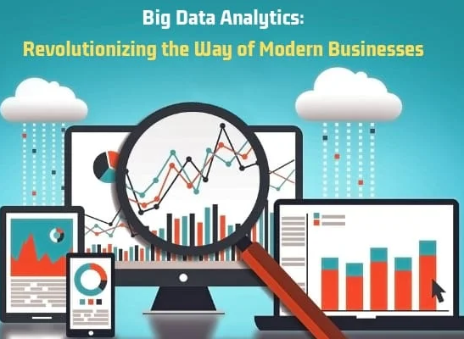
Big data analytics
Big Data analytics is a process used to extract meaningful insights such as trends of market, patterns, correlations and customer preferences.
Big Data analytics provides various advantages, as it can be used for various purposes including better decision making and fraud prevention activities.

Slide 14

Social media big data analytics pipeline

Slide 15
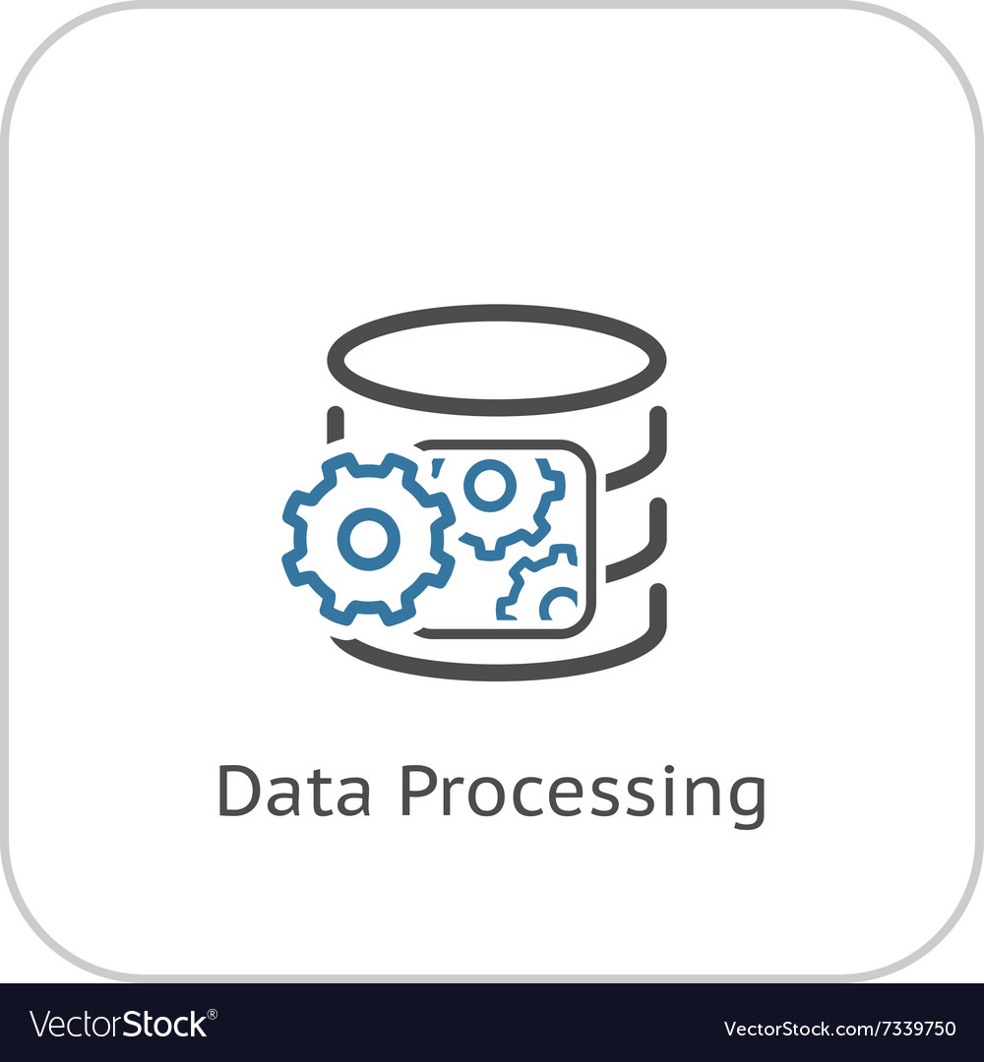

Social media big data analytics pipeline (CONtinue,.)

Slide 16
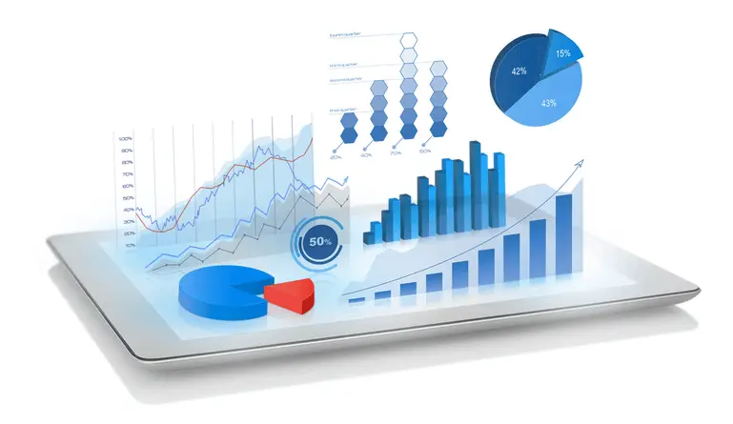
Social media big data analytics pipeline (CONtinue,.)

Slide 17
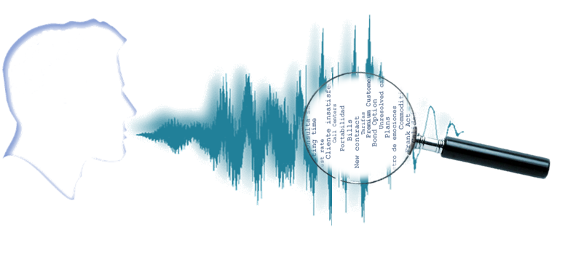


Audio analytics
Audio data analytics is about understanding and analyzing audio signals captured by digital devices, with numerous applications in the enterprises and productivity.
Social audio analytics is measuring the influence, engagement, growth, sentiment of social audio applications and networks.
Python Audio Libraries:
Librosa and PyAudio are the Python libraries for Audio analytics. There are various built-in modules for some basic audio functionalities. It provides the building blocks to create audio/music information retrieval & analytics.

Slide 18

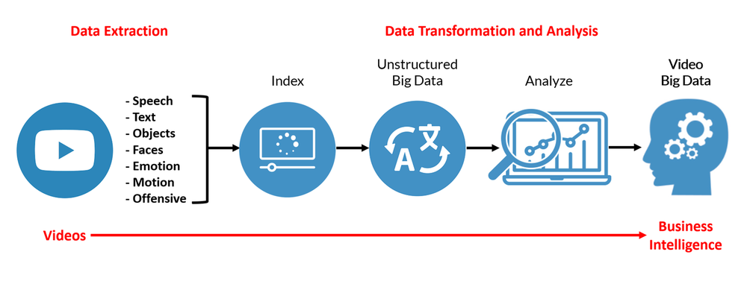
Video analytics
Video analytics displays a wide range of analytical functionalities that include the following functions,
Dynamic masking: Used to block a part of a video signal to maintain the privacy of an individual.
Object detection, Motion detection, Optical character recognition, Style detection from Data Extraction.
Python Video Libraries:
Python has some great libraries for video processing like VidGear and MoviePy.

Slide 19

AUDIO & VIDEO analytics applications
Indexing audio & video collections according to their features.
Recommending music, news for various channels
Similarity search for audio & video files
Speech processing and synthesis — generating artificial voice for conversational agents.

Slide 20

Image & graph mining
Image Mining
Image mining deals with the extraction of image patterns from a group of images. It is the extraction of meaningful information from images by digital image processing techniques.
Graph Mining
The task of graph mining is to extract patterns from graphs for classification or clustering. Graph Mining is used in Social Network Analysis, to investigate social structures through the use of networks & graph theory.

Slide 21
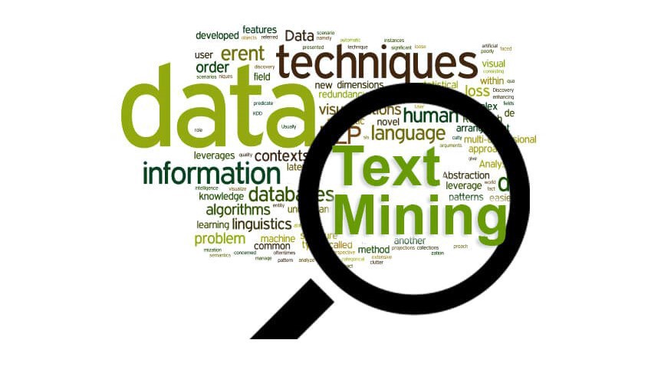
Text mining & machine learning
With text mining technology, we can analyze text information from various data sources such as online blogs, comment fields, social media posts , Social media profile information and other different text –based sources to find unseen insights and analytics we haven’t noticed before.
Text mining uses machine learning to go through and analyze documents, emails, blogs, twitter feeds for extract knowledge and see new relationships.

Slide 22
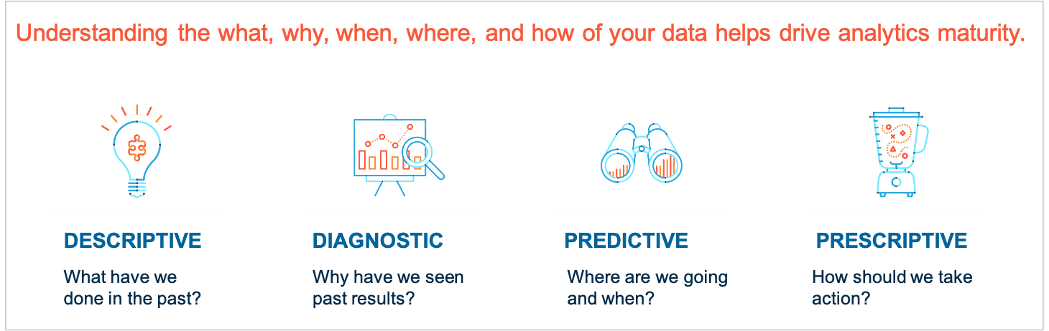
CLASsIFICATION OF SOCIAL MEDIA BIG DATA ANALYTICS BASED ON CHARACTERISTICS
The characteristic of analytics in big data can be divided into four types namely, descriptive, diagnostic, predictive, and prescriptive.
Descriptive analytics
Diagnostic analytics
Predictive analytics
Prescriptive analytics

Slide 23
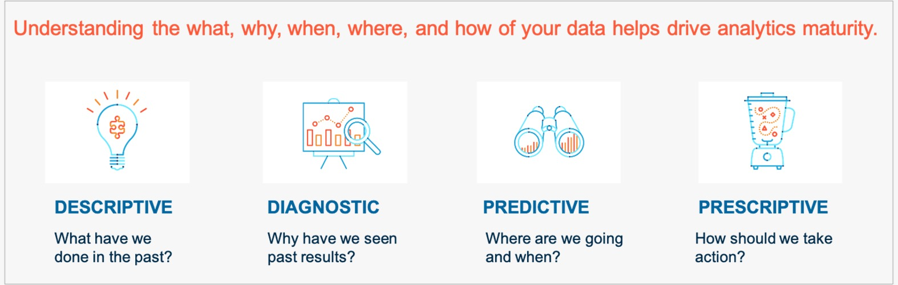
Descriptive analytics
The descriptive Social media analytics addresses the question "what happened in the past?".
Descriptive analytics captures and describes social media data in the form of reports, visualizations, and clustering to understand well-defined business problems or opportunities.
For example, the analytics of user comments on social media falls into the category of descriptive analytics. We can use comment analytics to cluster topics to understand emotions and identify new trends. Descriptive analytics now occupies most of the outlook for social media analytics.

Slide 24
Diagnostic analytics
Diagnostic Social media analytics deals with the question "Why something happened?”
Diagnostic Analytics can extract this data into a single view to see what worked and what didn't in past campaigns, why it was happened in past, etc.
Diagnostic analytics enablers include inference statistics, behavioral analysis, correlation and retroactive analysis, and results analysis of the causes and consequences of business problems.

Slide 25
Predictive analytics
Predictive analytics analyzes large amounts of aggregated social media data to predict future events.
It answers, the question “what will happen and/or why will it happen". For example, intent expressed through social media (buy, sell, recommend, desire, etc.) can be determined to predict future events (future purchase). Alternatively, a company can forecast sales based on past visits (or links) from Social medial data.

Slide 26
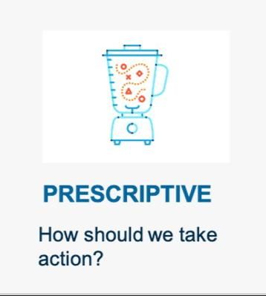
Prescriptive analytics
Prescriptive analytics suggest the best action to take and when & how to handle a scenario.
For example, if you have groups of social media users that show specific purchasing behavior patterns, Prescriptive analytics describe, how can you optimize the services of each group?
Key realization factors for prescriptive analytics include optimization and simulation modeling, multi-criteria decision modeling, expert systems, and group support systems.

Slide 27
Key capabilities of effective social media analytics
These steps are typical of a general social media analytics approach that can be made more effective by capabilities found in social media analytics platforms.
Natural language processing technologies
Segmentation
Behavior analysis
Sentiment analysis
Clustering analysis
Dashboards and visualization

Slide 28
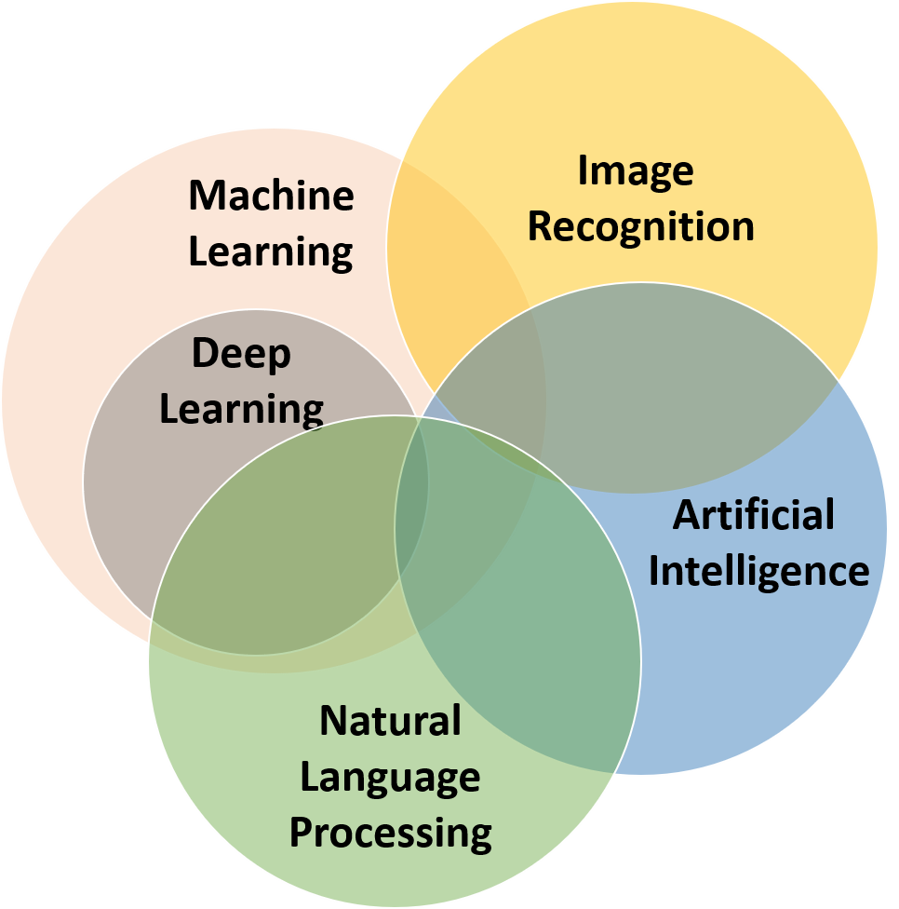
Natural language processing technologies
Natural language processing is a small part of Machine Learning and Artificial Intelligence. It’s main function to analyze the interconnection between computers and human natural languages.
Natural language processing is used in various social media analytics activities such as Speech recognition, sentiment analysis and relationship extraction.

Slide 29
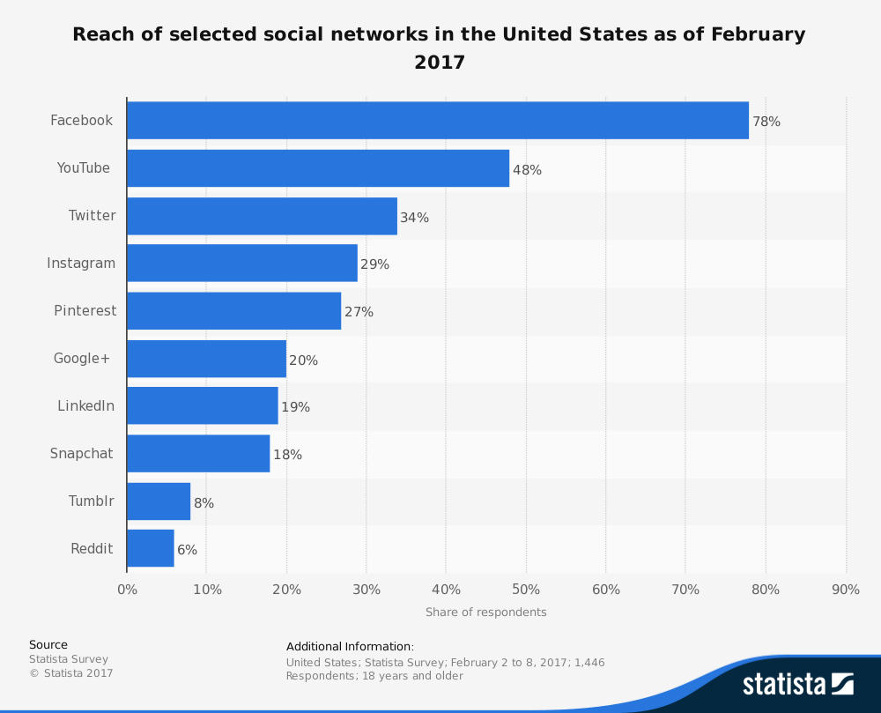
Segmentation
Segmentation means analyzing public geographically within and in between different social networking platforms. It provide us the behavior of various group of people using dissimilar social media sites.
The main purpose of segmentation is to let us know the use of which social media platform to reach out to the user by analyzing demographic information, behavioral habits and geographic location.

Slide 30
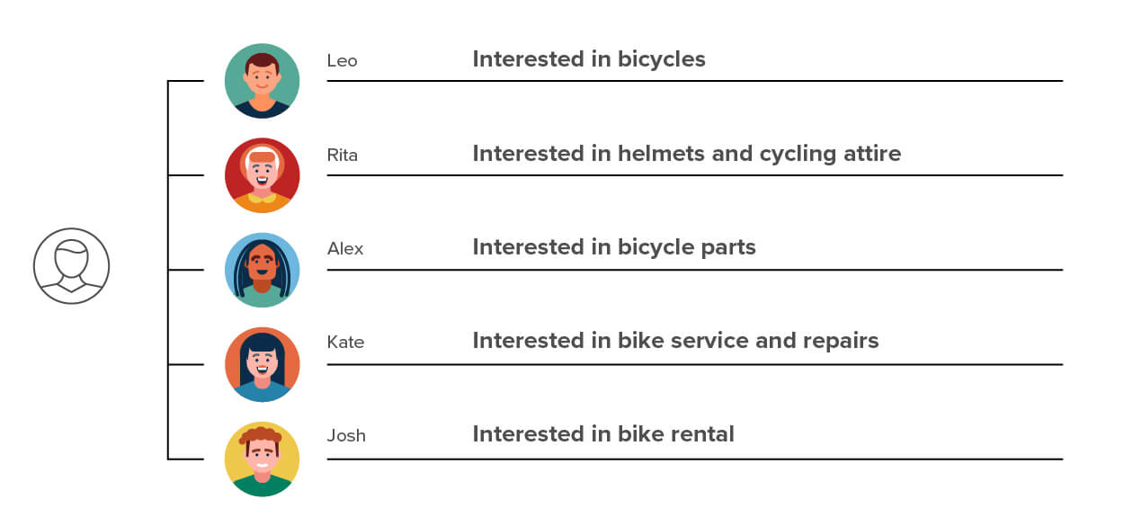
Behavior analysis
Behavior analysis is an part of big data analytics that provides information about action of people; For example, what do they purchase online, what kind of content they are looking for, how much time they spent on social media.
This is used in almost all the applications(e-commerce, gaming, social media and other applications) to identify the opportunity for greater business outcomes.

Slide 31
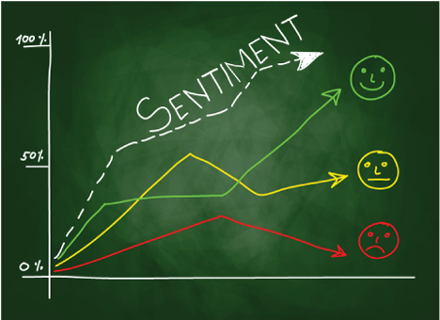
Sentiment analysis
Sentiment analysis used to gather insight from user about a product, service or a brand. It is a part of Social Listening.
It helps us to analyze customer’s review about a business and also to improve it from their feedback.

Slide 32
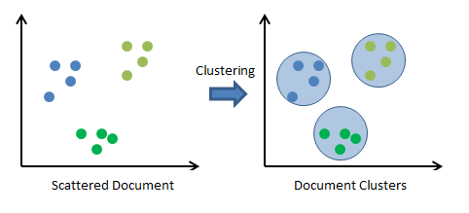
Clustering analysis
Cluster analysis is a mathematical method used to group homogeneous objects into respective categories. It is also known as taxonomy analysis or clustering.
It allows us to analyze various patterns between data element.
It is used in marketing, insurance and geology.

Slide 33
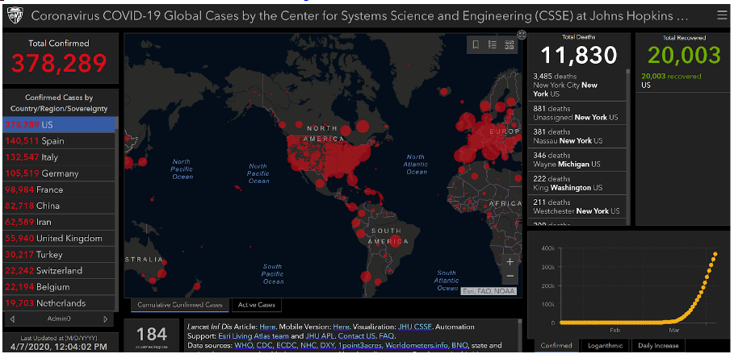
Dashboards and visualization
A Dashboard is a tool that provides us information on subscriber or follower and audience reviews.
Visualization is basically graphical representation of data which attracts customer’s attention and easily interpreted by everyone.

Slide 34
Organisations view for social media
Organizations are investing in big data analytics as a vital component for monitoring social media activity, especially on social networking sites like Facebook, Twitter, and LinkedIn. As a result, monitoring people's online behavior is becoming increasingly vital for their success.
Data on consumers' web surfing, online buying behavior, customer feedback, and marketing research on social networks makes it possible for businesses to acquire fast and comprehensive insights into their customers.
As a result, businesses can tailor their market intelligence strategies to meet specific goals such as advertising and product launches, public relations and brand management, customer loyalty, providing personalized services to customers, keeping track of market trends and competitors, reducing risk, and saving money.

Slide 35
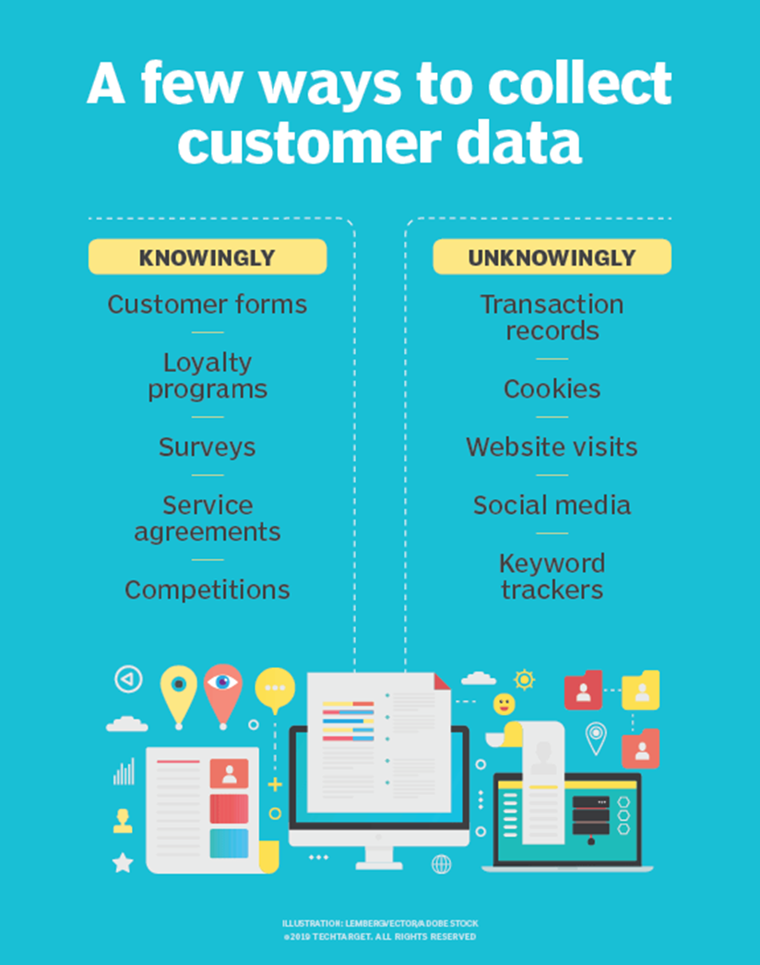

Slide 36
Decision making in organisation
Marketers may utilize big data to discover social media trends and acquire insights, which can be used to make engagement decisions such as which people to contact with, which set of users should get marketing emails, and so on.
It also enables keeping track of demographics and deciding which social media site to target easier. Big data allows businesses to readily grasp market attitudes, allowing them to develop winning strategies.
Big data assists in making educated decisions to better meet the future demands and expectations of consumers, rather than depending simply on historical performance to determine what improvements are necessary.

Slide 37
Product Insights
Social media marketers can effectively use big data to judge future buying patterns and trends. Big data increases the certainty regarding what consumers want, when they want it, and how they want it. This gives businesses insights into what their new products should be like.
Businesses can utilize big data to analyze the choices of people, their complaints, what products are missing, faults in the products, etc. This will enable them to make changes in the current product and come out with new innovative products.

Slide 38
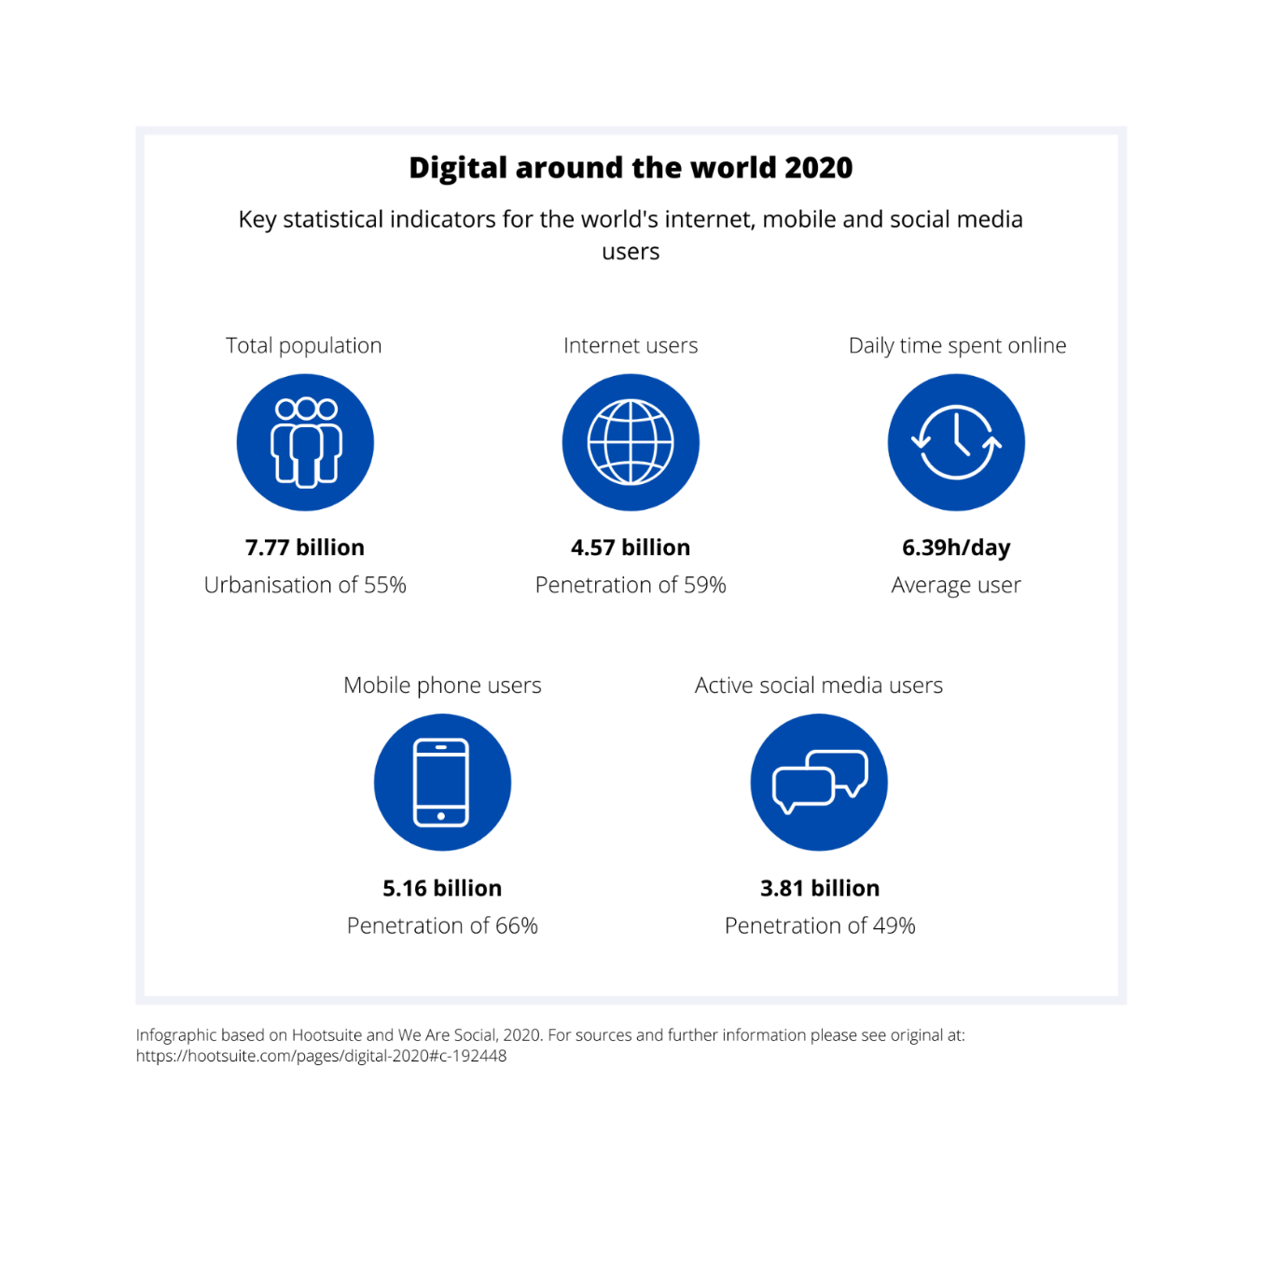
Social media

Slide 39
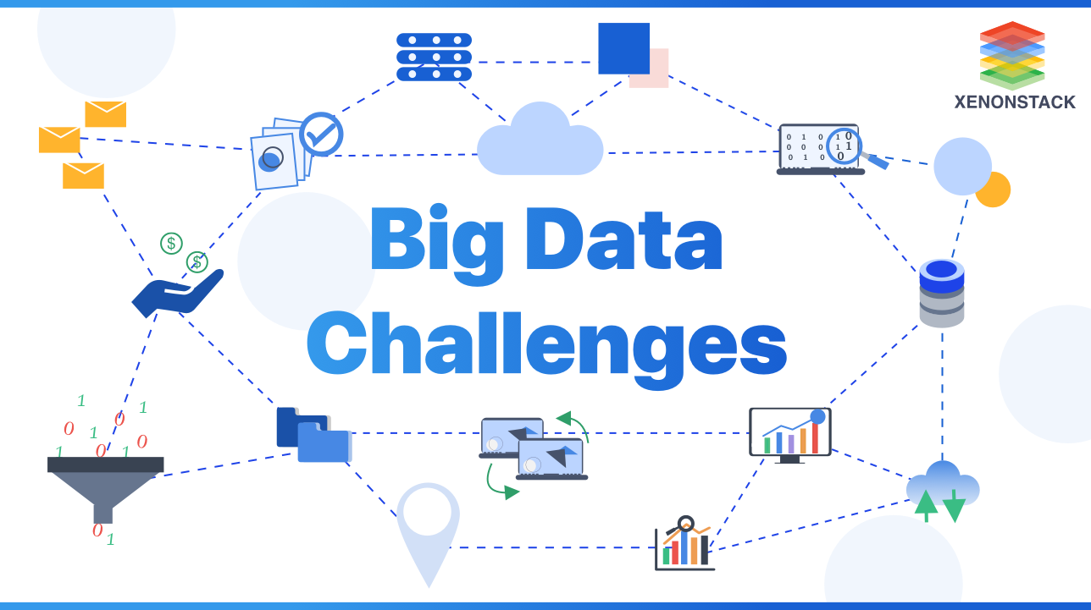
Research Challenges
Big data analytics on social media provide tremendous benefits to businesses and individuals in terms of making good decisions. Nonetheless, Several issues remain unresolved.
To address similar challenges, some big data problems necessitate concentrated perspiration from the big data exploration communities, companies, and government.

Slide 40
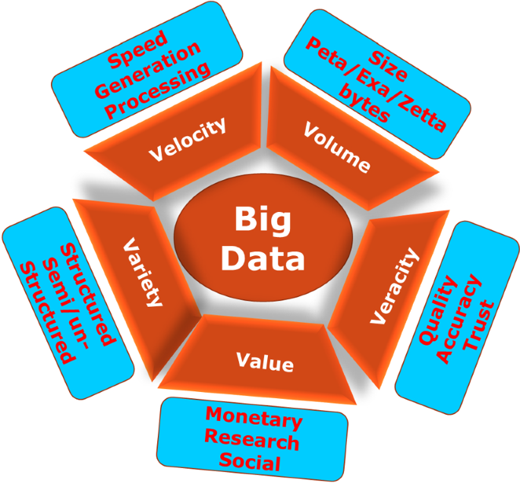
challenges of big data analytics
There are various challenges in analytics of big data
in the following dimension,…
Volume
Velocity
Variety
Variability
Veracity
Value and
Availability

Slide 41
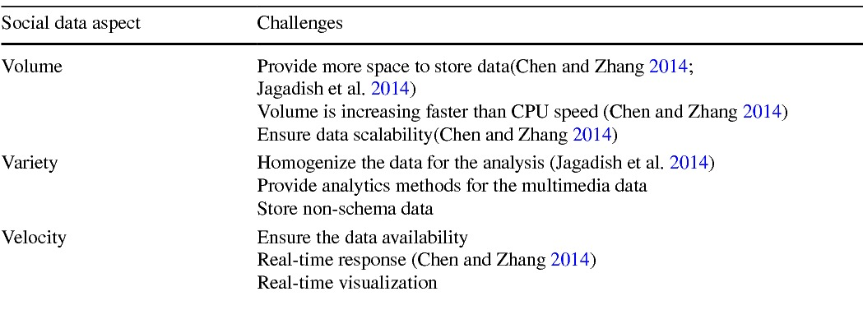
OVERVIEW of challenges

Slide 42

Volume
The growth in data volume is due to a number of things. Data based on transactions that has been stored throughout time. Unstructured data pouring in from social media. The amount of sensor and machine-to-machine data being gathered is growing.
Excessive data volume used to be a storage issue, but as storage costs have decreased, other issues have emerged, such as how to assess relevance within high data volumes and how to apply analytics to produce value from relevant information.

Slide 43
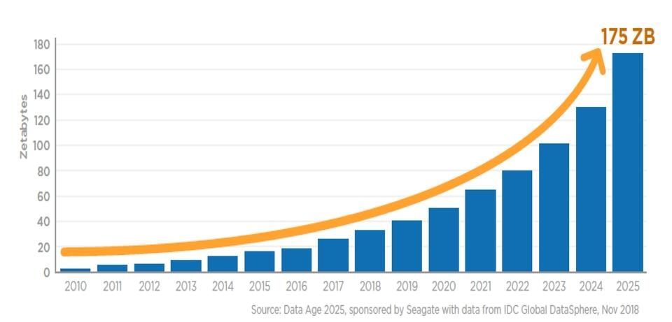
Volume

Slide 44
Velocity
Data is coming in at an incredible rate, and it needs to be processed quickly.
The need to deal with massive amounts of data in near-real time is being driven by Radio frequency identification (RFID) tags, sensors, and smart meters.
Most businesses find it difficult to react quickly enough to keep up with data generating speeds.

Slide 45
Velocity
In the year 2000, Google was receiving 32.8 million searches per day. As for 2018, Google was receiving 5.6 billion searches per day!
Approximate monthly active users as of 2018: Facebook: 2.41 billion Instagram: 1 billion Twitter: 320 million LinkedIn: 575 million

Slide 46
Variety
Today's data comes in a variety of formats.
Traditional databases contain structured, numeric data.
Information derived from line-of-business applications.
Unstructured text documents, email, video, audio, stock ticker data, and financial transactions.
Many organizations are still struggling with managing, combining, and governing various types of data.

Slide 47
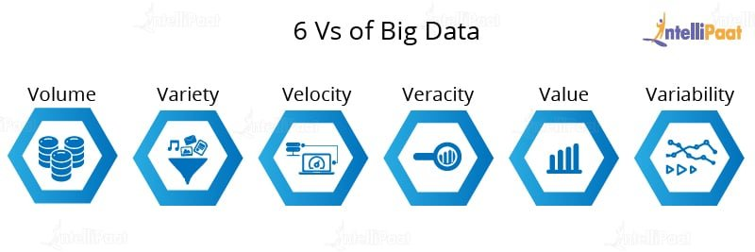
Variability
In addition to the increasing velocities and forms of information, information flows can be highly inconsistent with periodic peaks.
Daily, seasonal and event-caused peak information may be difficult to manage, even more so with unstructured information involved.

Slide 48
Veracity
Refers to ensuring the quality, integrity, reliability, accuracy of data.
Since data is collected from multiple sources, we need to check the data for accuracy before using it to gain business insights.

Slide 49
Value
Just because we collected many Data, it’s of no value unless we garner some insights out of it.
Value refers to how useful the information is in deciding.
we'd like to extract the worth of the large Data using proper analytics.

Slide 50

Availability
Machine learning techniques rely solely on the availability of data. As a result, before learning can begin in machine learning, the entire dataset must be available.
Furthermore, a model typically learns from the training set and then applies what it has learned to perform tasks like prediction and classification.
However, in the case of data streaming, where new data is constantly arriving, this scenario cannot be realized.

Slide 51
Social media big data analytics Research gap
In Data analytics in search of important data, we are getting lots of irrelevant data from social media, which requires a more effort for Preprocessing
Nowadays, Due to Big data analytics privacy & information security became a critical issue as even person can be tracked by their single click.

Slide 52
conclusion
Big data on social media is analyzed using a variety of techniques and tools. One of the most important factors is identifying large social data techniques and tools. Therefore, this study provides tools and techniques for different phases of big data analysis on social media.
Current work focuses on studying the joint interaction between social media analytics and Big Data. Based on the results obtained, the paper ends with establishing a specific kind of alliance between social media analytics and Big Data.
Overall, this study can serve as an initial guide for those considering analytical processing of social media data, providing them with a clear view of the processing steps involved in social media analytics. Social media analytics and Big Data-developed technologies applied at each stage of the pipeline.

Slide 53
references
Sahatiya., P, 2018, Big Data Analytics on Social Media Data: A Literature Review, IRJET, 5(2), 189-192,
https://www.irjet.net/archives/V5/i2/IRJET-V5I245.pdf
Sebei, H., Taieb, M. A., Aouicha, M. B.,(2018) Review of social media analytics process and Big Data pipeline, Social Network Analysis and Mining (2018), 30(8), 1-28
https://doi.org/10.1007/s13278-018-0507-0
Gaikwad, M., (2018), What Is Social Media Analytics? Definition, Best Practices, and Examples
https://www.toolbox.com/marketing/social-media/articles/what-is-social-media-analytics/
Ghani, N. A., Hamid, S., Hashem., Ahmed, E. (2018), Social media big data analytics: A survey,,
https://doi.org/10.1016/j.chb.2018.08.039
https://www.oracle.com/big-data/what-is-big-data/
https://www.ibm.com/topics/social-media-analytics#:~:text=Social%20media%20analytics%20is%20the,those%20decisions%20through%20social%20media.
Khan, G., (2019), 4 types of social media analytics explained, https://www.analytikus.com/post/2019/05/02/4-types-of-social-media-analytics- explained#:~:text=Descriptive%20Analytics%20(Is%20Reactive%20in,defined%20business%20problem%20or%20opportunity.
Chauhan, N, S., (2020), Audio Data Analysis Using Deep Learning with Python.https://www.kdnuggets.com/2020/02/audio-data-analysis-deep-learning-python-part-1.html

Slide 54
References
https://towardsdatascience.com/leveraging-on-nlp-to-gain-insights-in-social-media-news-broadcasting-ca89752ef638
https://blog.capterra.com/social-media-segmentation-can-boost-your-marketing/
https://blog.hubspot.com/marketing/segment-social-media-audience#:~:text=Social%20media%20segmentation%20is%20the,interests%20of%20a%20specific%20audience.
https://www.investopedia.com/terms/b/behavioral-analytics.asp
https://sproutsocial.com/insights/social-media-sentiment-analysis/
https://www.alchemer.com/resources/blog/cluster-analysis/
https://www.klipfolio.com/resources/dashboard-examples/social-media
https://whatagraph.com/blog/articles/social-media-data-visualization
https://www.migrationdataportal.org/themes/big-data-migration-and-human-mobility
https://www.cambridgeassessment.org.uk/Images/465808-big-data-and-social-media-analytics.pdf
https://www.techtarget.com/searchcio/definition/data-collection
https://insidebigdata.com/2018/10/06/4-major-ways-big-data-impacting-social-media-marketing/
https://buffer.com/state-of-social-2019
https://www.cambridgeassessment.org.uk/Images/465808-big-data-and-social-media-analytics.pdf
https://www.techtarget.com/searchcio/definition/data-collection
https://insidebigdata.com/2018/10/06/4-major-ways-big-data-impacting-social-media-marketing/
https://insidebigdata.com/2018/10/06/4-major-ways-big-data-impacting-social-media-marketing/

